Slide 1
DAX FUNCTION
BI Academy

Slide 2
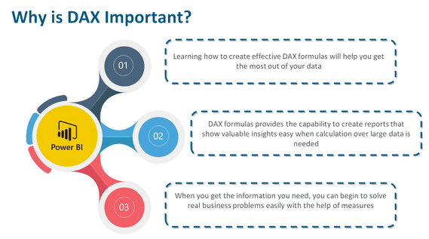

Slide 3
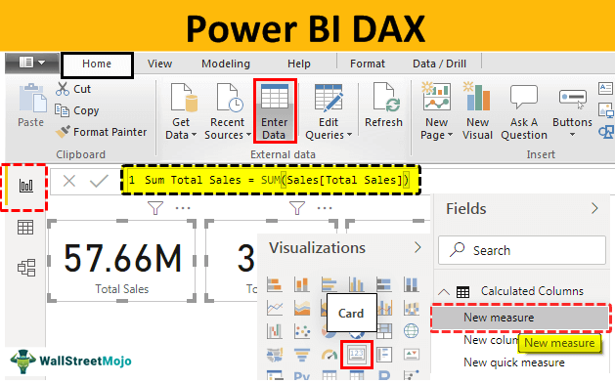

Slide 4
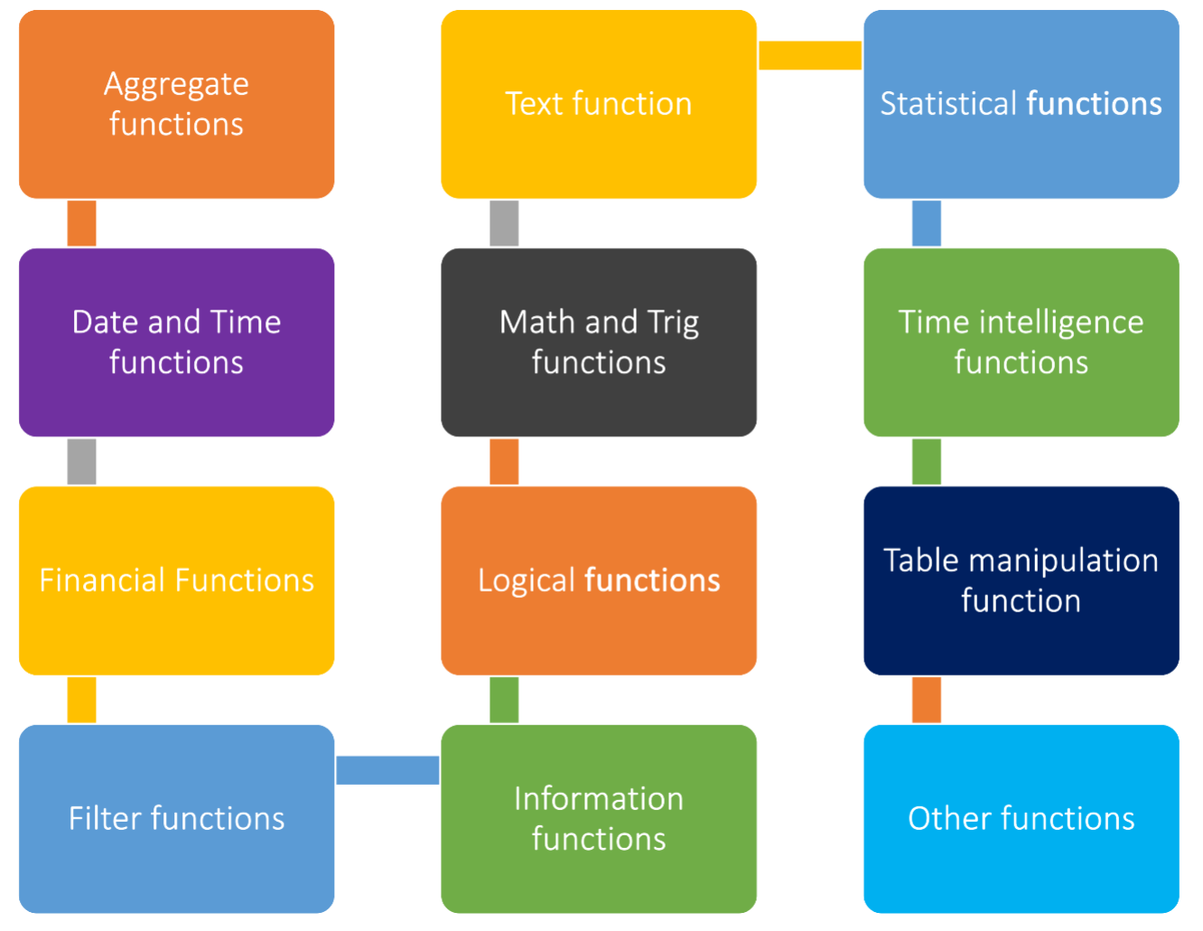
Types of dax functions

Slide 5
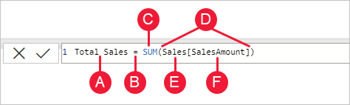
This formula includes the following syntax elements:
A. The measure name, Total Sales.
B. The equals sign operator (=), which indicates the beginning of the formula. When calculated, it will return a result.
C. The DAX function SUM, which adds up all of the numbers in the Sales[SalesAmount] column. You’ll learn more about functions later.
D. Parenthesis (), which surround an expression that contains one or more arguments. Most functions require at least one argument. An argument passes a value to a function.
E. The referenced table, Sales.
F. The referenced column, [SalesAmount], in the Sales table. With this argument, the SUM function knows on which column to aggregate a SUM.

Slide 6
SUM
Total Sales = SUM('master table'[Sales])
The DAX formula Total Sales = SUM('master table'[Sales]) calculates the sum of the 'Sales' column in the 'master table', giving you the total sales amount. You can use similar formulas to create other measures or calculated columns based on your specific analysis requirements.

Slide 7
SUMX
Total Sales per Customer = SUMX(VALUES('master table'[Customer ID]), CALCULATE(SUM('master table'[Sales])))
The SUMX function is used to sum the result of an expression evaluated for each row in a table.
Here's an example of how you might use SUMX:
Let's say you want to calculate the total sales for each customer by summing the 'Sales' column for each order they made.
In this example: VALUES('master table'[Customer ID]) provides a table of unique customer IDs. CALCULATE(SUM('master table'[Sales])) calculates the total sales for each customer using the context of the customer ID.
This measure, when placed in a visual or a table, will give you the total sales for each unique customer.

Slide 8
AVERAGE
Avg Sales per Order = AVERAGE('master table'[Sales])
is a measure that calculates the average sales amount per order in the 'master table’.
This is a straightforward calculation, and it should work as intended.
If you're encountering an error while creating a new table, it's important to understand the context in which you are trying to use this measure.
Measures are typically used in visualizations, cards, or tables to provide aggregated results. I
f you are trying to use this measure in a calculated column in a new table, it might not work as expected because measures are intended for use in the context of visualizations. Calculated columns in tables should typically use column-wise operations rather than aggregation functions like AVERAGE.

Slide 9
AVERAGEX
Average Sales and Profit per Order =
AVERAGEX(
'Master Table',
'Master Table'[Sales] + 'Master Table'[Profit]
)
This formula iterates over each row in the 'Master Table' and calculates the sum of 'Sales' and 'Profit' for each row.
Then, it calculates the average of these sums, giving you the average sales and profit per order.

Slide 10
COUNT and countrows
Count custID=
COUNT('Master Table'[Customer ID])
Num Orders = COUNTROWS('master table')
Count function Counts the number of rows in the specified column that contain non-blank values.
You can use the COUNT function to count column values, or you can use the COUNTROWS function to count table rows. Both functions will achieve the same result, providing that the counted column contains no BLANKs.

Slide 11
MAX
Max Sales = MAX('master table'[Sales])
This DAX formula calculates the maximum value from the 'Sales' column in the 'master table'. You can use a similar approach to create measures or calculated columns for other maximum-related analyses.

Slide 12
CALCULATE
Central Region Orders = CALCULATE(COUNTROWS('Location Table'), 'Location Table'[Region] = "Central")
COUNTROWS('master table'): This part of the formula counts the number of rows in the ‘location table' without any filters. CALCULATE(..., 'master table'[Region] = "Central"): This part of the formula modifies the filter context for the 'master table' by specifying that it should only consider rows where the 'Region' column is equal to "Central".

Slide 13
TOPN
Top 5 Products Sales =
CALCULATE(
SUM('master table'[Sales]),
TOPN(5, ALL('master table'), 'master table'[Sales], DESC))
It calculates the sum of 'Sales' for the top 5 products based on their sales amounts in descending order across the entire 'master table'. Here's a brief breakdown:
CALCULATE(SUM('master table'[Sales]), ...): This part of the formula calculates the sum of 'Sales' within the specified context.
TOPN(5, ALL('master table'), 'master table'[Sales], DESC): This part determines the top 5 rows from the 'master table' based on the 'Sales' column in descending order.
The ALL('master table') ensures that the calculation considers the entire table without any filters.

Slide 14
DISTINCT
count_distinct_rows = COUNTROWS(DISTINCT('Master Table'[Customer ID]))
It uses the COUNTROWS function in combination with DISTINCT to count the number of distinct values in the 'Customer ID' column from the 'Master Table'. This will give you the count of unique customer IDs in your dataset.
This measure will return the total number of unique customer IDs in the 'Master Table'. If you want to count distinct rows based on multiple columns, you can modify the formula accordingly.

Slide 15
FILTER
create a new table not new measure or column
FilteredTable = FILTER('Master', 'Master'[Ship Mode] = "Standard Class")
FilteredTable = FILTER('Master', 'Master'[Category] = "Office Supplies")
FilteredTable = FILTER('Master', 'Master'[Profit] > 0)
FilteredTable = FILTER('Master', 'Master'[Region] = "Central")
FilteredTable = FILTER('Master', 'Master'[Sales] > 100)
You can use FILTER to reduce the number of rows in the table that you are working with, and use only specific data in calculations. FILTER is not used independently, but as a function that is embedded in other functions that require a table as an argument.

Slide 16
IF
Creating a New Column to Identify Profitable Sales:
ProfitableSales = IF('master table'[Profit] > 0, "Profitable", "Not Profitable")
SalesCategory = IF('master table'[Sales] > 100, "High Sales", "Low Sales")
ShippingModeDecision = IF('master table'[Segment] = "Consumer", "Standard Class", "Express")

Slide 17
SWITCH
Creating a New Column:
Switch_Category_Profit =
SWITCH ('Orders'[Category],
"Office Supplies", IF('Orders'[Profit] > 0, "Profitable", "Not Profitable"),
"Furniture", IF('Orders'[Profit] > 0, "Profitable", "Not Profitable"),
"Technology", IF('Orders'[Profit] > 0, "Profitable", "Not Profitable"),
"Other", "Uncategorized"
)

Slide 18
DIVIDE
Creating a New Measure:
Profit Margin = DIVIDE(SUM('master table'[Profit]), SUM('master table'[Sales]))

Slide 19
Time intelligence functions
Data Analysis Expressions (DAX)
Data Analysis Expressions (DAX) includes time-intelligence functions that enable you to manipulate data using time periods, including days, months, quarters, and years, and then build and compare calculations over those periods.
Before using any time-intelligence functions, make sure to mark one of the tables containing date column as Date Table.

Slide 20
DATESBETWEEN
Returns a table that contains a column of dates that
begins with a specified start date and continues until a specified end date.
Create new measure and cross check with date slicer
Customers Order Date time Intelligent function =
CALCULATE(
DISTINCTCOUNT('Order Table'[Order ID]),
DATESBETWEEN(
'Order Table'[Order Date],
DATE(2017, 12,20),
MAX('Order Table'[Order Date])
)
)
CALCULATE: This function is used to modify the context in which a formula is being evaluated.
DISTINCTCOUNT('Order Table'[Order ID]): This calculates the distinct count of 'Order ID' in the modified context.
DATESBETWEEN('Order Table'[Order Date], DATE(2017, 12, 20), MAX('Order Table'[Order Date])):
This filters the data based on the date range specified, ensuring only data within that range is considered.

Slide 21
THANK YOU
BI Academy

